Slide 1
ECE3720 Final Project
HCS12 Space Time
Nicholas Musienko
Matthew Bellafaire

Slide 2
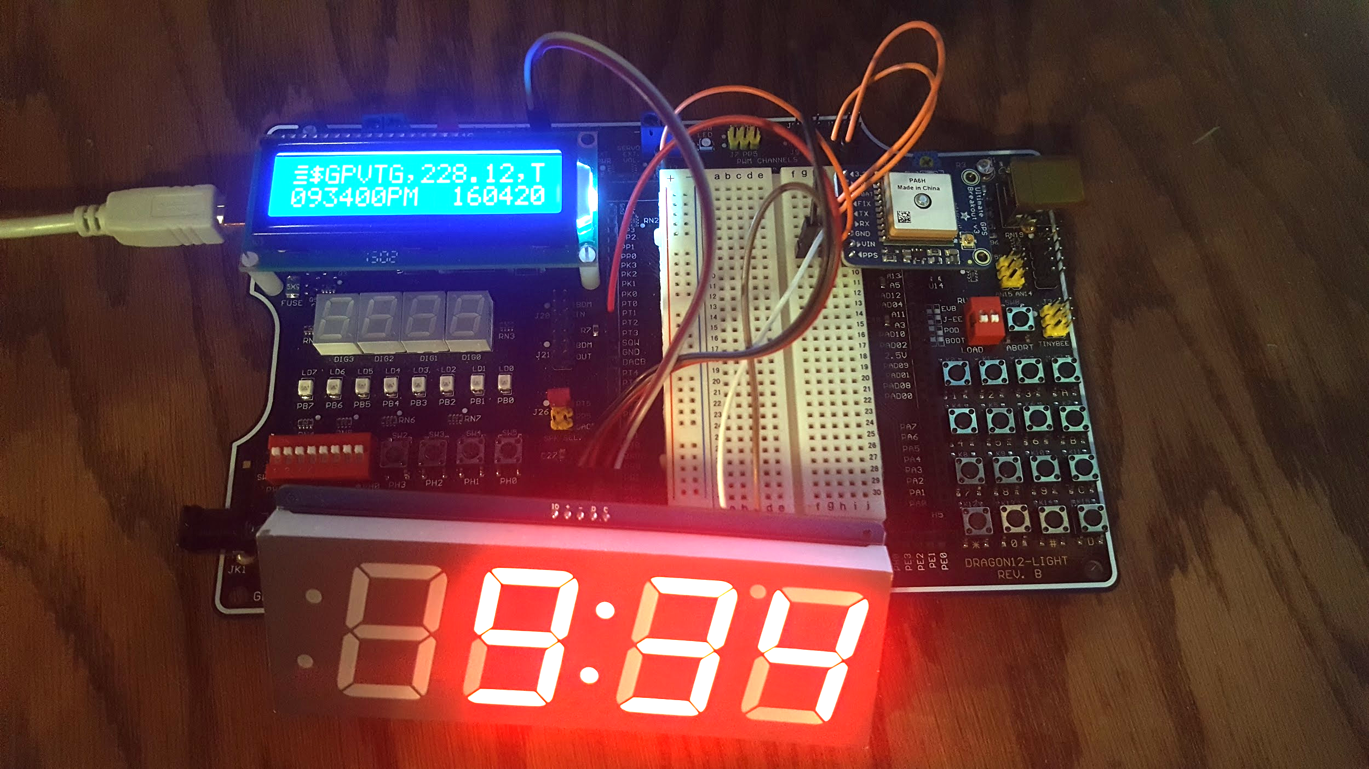
Overview
The goal of this project was to create a clock which could automatically set its own time without any user input. This was achieved by parsing data from the Global Positioning System (GPS) satellites by using an external GPS module. The raw data from the module is then parsed to extract time and date information. Finally the time is displayed on an external I2C display.

Slide 3
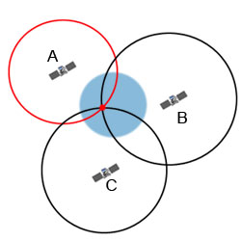
Short Overview of GPS
GPS satellites send out constant information about their position and the current date and time. GPS receivers use the time data they received in conjunction with the known time in order to determine the distance to the satellite by calculating the travel time of the radio waves multiplied by the speed of light.
Image Source: http://www.physics.org/article-questions.asp?id=55

Slide 4
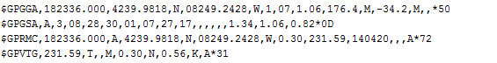
What if you don’t care about position?
The equations to solve for position on the earth’s surface are complex, however most GPS receivers handle those calculations.
The data provided is given in a standardized NMEA sentence.
NMEA sentences contain date and time (of transmission) and positional information among other things.

Slide 5
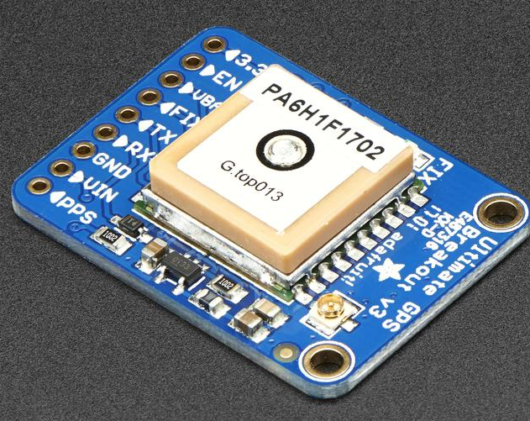
Receiving Global Positioning System Data
We used the Adafruit Ultimate GPS Breakout V3 module to receive GPS data
This module communicates 4 NMEA sentences (GPGGA, GPGSA, GPRMC, and GPVTG) over UART at 9600 baud by default.
There is no requirement to send commands to the module unless we want specific NMEA sentences. NMEA Sentences are sent once every second
For our project we chose only to receive data from the module without issuing any commands.
Image Source: https://www.adafruit.com/product/746

Slide 6
Receiving UART data using SCI1
Steps for setting up UART receiving on the HCS12:
Figure out E-clock speed and set SCI1BDH and SCI1BDL to the appropriate divider values to obtain the desired baud rate (@24MHz with desired 9600 baud SCI1BDL = 156 SCI1BDH = 0)
Configure SCI1CR1 if 9 bit data frame is needed or a parity bit is required.
Configure SCI1CR2 and set RE (receive enable bit) to 1
If more than one byte needs to be received at a time set REI (receiver full interrupt enable bit) to 1 to enable receiver interrupts.
Create ISR for receiver full interrupt using Vsci1 and move data out of data register when necessary.
Obtain bytes received from SCI1DRL as they appear

Slide 7
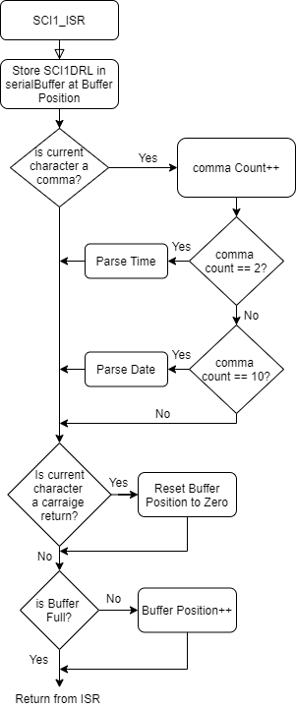
Receiving and parsing NMEA sentences from GPS module
With REI bit set to 1 on SCI1CR2 the SCI1 interrupt will be triggered whenever the 8-bit receive buffer of the SCI1 module is full.
To receive an entire NMEA sentence a char array was created to act as a buffer for incoming characters, on the interrupt we store the current byte received from SCI1DRL to the input buffer.
We also perform data parsing inside the ISR

Slide 8
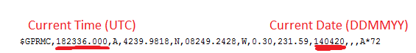
Obtaining time data from NMEA Sentence
NMEA sentences have a fixed data order separated by commas, in the event that a value isn’t present the space will be left empty.
To parse out the time and date data the the code counts the commas then uses their position to determine which characters to extract. We take our time and date data from the GPRMC sentence whenever it is stored in the serial buffer.
To parse out time we use the commas position as a relative position eg. time is before the second comma of GPRMC and is the 18th character in the serial buffer, the 10’s digit of the hour will be at the comma’s position - 10.

Slide 9
Time keeping
Since the data is automatically parsed in the ISR the current time is constantly updated by the incoming data from the GPS. Once the UART is initialized the code can essentially be forgotten about calling getTimeString() will always return the current time.
Using the ISR allows for the code to run more efficiently since the microcontroller only needs to buffer the data when it is received. The ISR is also able to run concurrently with most other code.
Since the time is given in 24 hour UTC, an additional function converts the received time to EST.

Slide 10
Why the LCD?
Provided a secondary option in case I2C could not be made to work
Allowed for the display of internal data and GPS readouts without a serial monitor for both debug and functional purposes
Function written to take any array of characters and display it on either row of the LCD

Slide 11
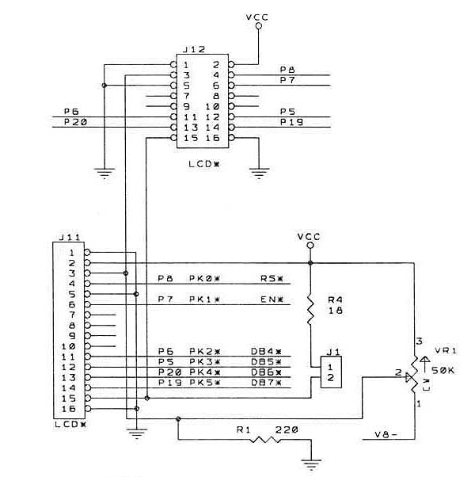
How to communicate with the LCD
Register Select (RS) - Selects which register to write data to
D4-D7 - The four data pins necessary to send information to the LCD.
There are technically 8, but only 4 are necessary.
Enable (E) - The pin used to latch data into the requested register.

Slide 12
Writing Commands/Data to the LCD
To Send Data/Commands
Set RS to 0 for command or 1 for data
Set R/W low (to write)
Put the 4 MSBs on D4 - D7
Bring E high for a length of time
Bring E low
Put the 4 LSBs on D4 - D7
Bring E high for a length of time
Bring E low
Wait for execution to finish
Some Specific Commands Used
0x01 - Clears the LCD
0x02 - Sets the cursors position to the first cell in the first row
0x06 - Sets cursor to auto-increment
0x0C - Turns the display on and the cursor off
0x80 - Sets cursor to first cell in first row
0xC0 - Sets cursor to first cell in second row

Slide 13
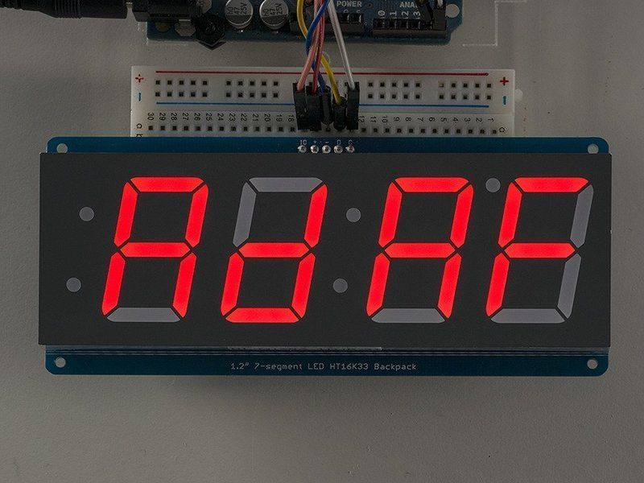
7 - Segment Display
The 7-segment display chosen was the Adafruit 1.2” 7-Segment Display with Backpack.
The “backpack” consists of a PCB driven by a HT16K33 LED driver IC, which communicates over I2C.
On the HCS12, there is a IIC module that is I2C compatible.

Slide 14
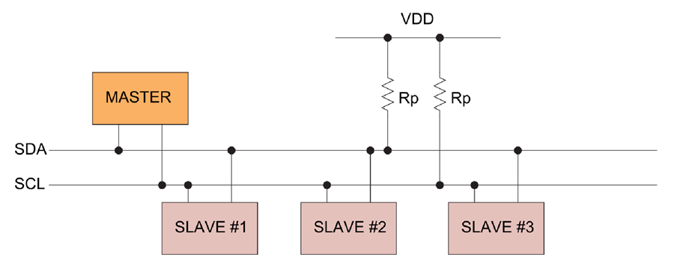
What is I2C?
A two-wire data transfer protocol that is both bidirectional and synchronous
Masters request reads and writes from slaves, each slave has their own address
There can be multiple masters and slaves on the same bus

Slide 15
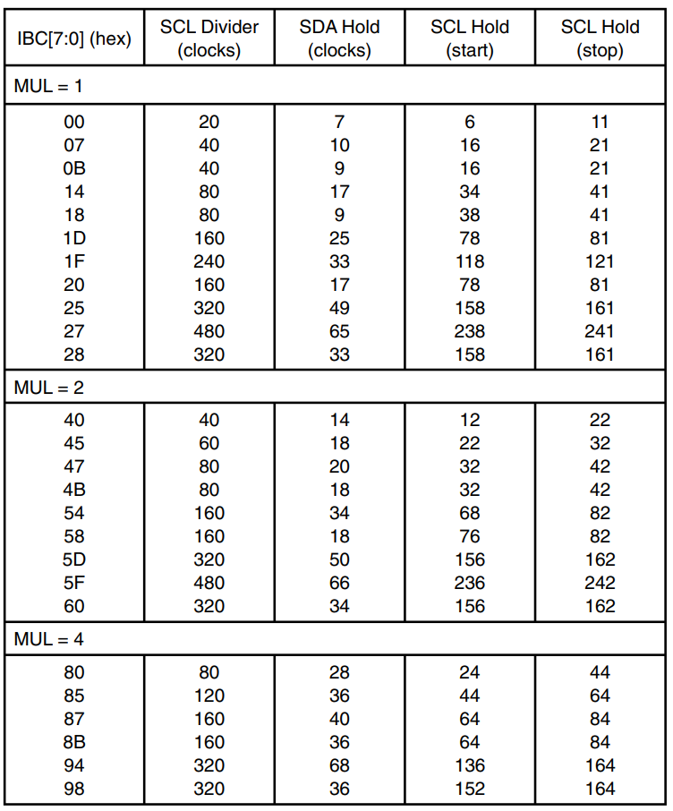
Initializing the IIC Module
Updating the IIC Frequency Divider Register (IBFD) to set the appropriate I2C bus clock value.
Bus Clock / SCL Clock Value = SCL Divider
See figure
Updating the IIC Bus Address Register (IBAD) to set the value that the HCS12 should respond to in slave mode.
Since the HCS12 is never in slave mode, this value does not matter
Updating the IIC Bus Control Register (IBCR) to enable the IIC module and set appropriate settings.
IBEN - Enables the IIC Module
MS/SL - Selects whether the HCS12 should be in master or slave mode
Tx/Rx - Selects whether the HCS12 will be transmitting or receiving data

Slide 16
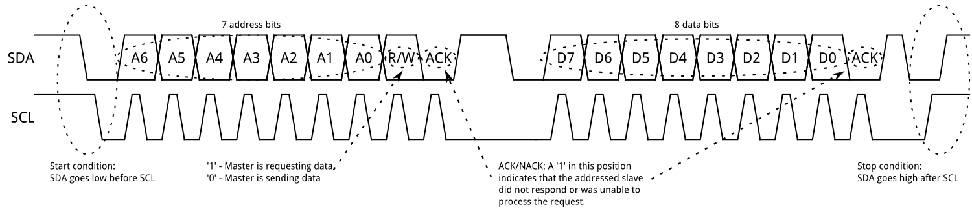
Transmitting Data over I2C Bus
The start and stop conditions tell devices on the bus when a master is preparing to communicate
Toggling the MS/SL bit from 0 to 1 generates a start condition, and 1 to 0 generates a stop condition
Before each transmission, the address bits and the R/W bit must be sent.

Slide 17
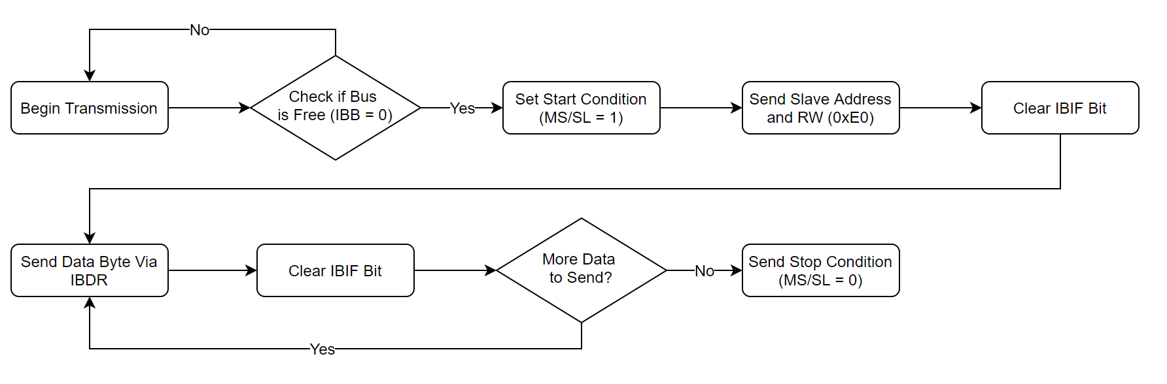
Transmitting Data over I2C
The IIC Bus Status Register (IBSR) has a couple of bits that help in making this possible:
IBB - Gets set if the I2C bus is busy (a start condition detected) and clears when a stop condition is detected.
IBIF - Flag that gets set when a byte is successfully transmitted along the I2C bus.

Slide 18
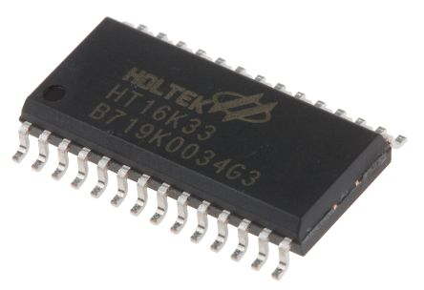
The HT16K33 LED Driver
The HT16K33 is a general purpose LED driver with a default address of 0x70
With the R/W bit added to it, the address byte becomes 0xE0
In order to start the display, the following commands must be sent:
System Set - Turns on the Internal Oscillator
Display Set - Turns on the display (and sets a blinking frequency)
Brightness Set - Sets the Brightness of the LEDs

Slide 19
Writing to the HT16K33
The first 8 sequential memory locations are mapped to LEDs on the display.
Each location is 16 bits wide, and are addressed by bytes
0x00 is the low byte and 0x01 is the high byte of the first location…
The first, second, fourth and fifth memory locations are connected to the digits of the display.
The third memory location controls the colon and the pips on the left
The command 0x00 sets the internal pointer to the start of the first memory location, and with each new byte read the pointer increments by 1.
This means all a function has to do is send the command 0x00, then 16 bytes to fill the HT16K33’s memory locations
This is done by the HCS12 with a buffer array of unsigned ints

Slide 20
Pulling it all together!
The GPS module constantly sends data to the HCS12, which parses it into a time and date.
This time and date get added to a display buffer for the LCD alongside the beginning of the latest GPS command, which then updates the LCD.
The time then gets added to another buffer for the 7-segment display, and a function call turns that buffer into data sent to the 7-segment display to update it with the current time.

